Slide 1
Tim Hawkinson
Artist…
Or
Mad Scientist?

Slide 2
Background
Born in 1960 in San Francisco California
Graduated from San Jose State with a BA in Art
Went on to receive his MFA from UCLA 1989
Hawkinson is best known for his large breath of complex sculptural work and his use of unique, simple, and sometimes ORGANIC material
Some of his biggest influences for creation are: the use of time, NATURE, and technology
Much of his work ends up looking and feeling more like a science experiment then the work of a professional trained artist

Slide 3
Introduction to ORGANIC MATERIALS
Hawkinson often played around with unconventional ORANIC materials to create some of his more complex 3-Deminsonal Sculpture work
This gallery showing of his work “Light and Space” features a few of the most minimal ORGANIC, yet prolific elements of 3- Dimensional Art.
His unconventional use of materials goes much further then that…….
https://www.youtube.com/watch?v=qSG3gyF0XjQ

Slide 4
What is considered an ORGANIC Material?
“organic
adj
1 of, relating to, derived from, or characteristic of living plants and animals
2 of or relating to animal or plant constituents or products having a carbon basis
3 of or relating to one or more organs of an animal or plant
4 of, relating to, or belonging to the class of chemical compounds that are formed from carbon “

Slide 5
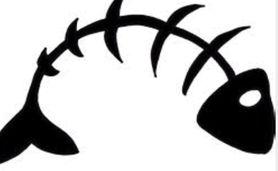
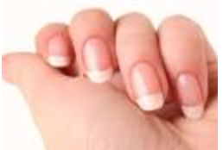
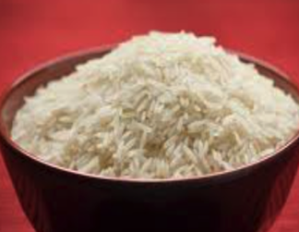
REMEMBER ME? THE CREEPY BIRD?
TIM HAWKINSON’S “THE BIRD”
IS CREATED WITH COMPLETELY
ORGANIC MATERIAL. WHAT
COULD THIS MATERIAL BE?
1. 2. 3.

Slide 6
FINGERNAILS!
Tim Hawkinson used a collection of his own fingernail clippings which he carefully glued together to create this realistic form of a bird
He also frequently uses eggshells, hair, different types of wood, and natural fabrics to create his unique designs

Slide 7
Other Examples
Based on what we have learned about
ORGANIC materials what are some
Other examples that we could use?
Remember Nature is everywhere!

Slide 8
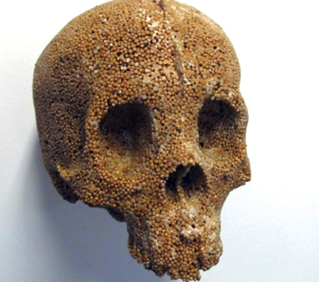
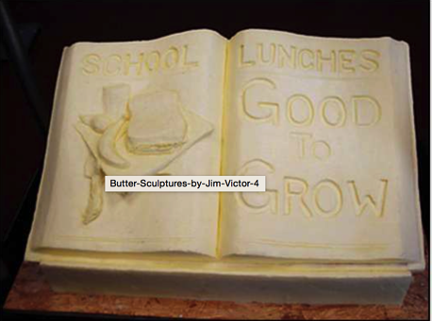
The Ultimate in Organic
How many different ways can this medium be used?
2. Jim and Marie Victor’s
Butter Carvings
1. Helen Altman's “skulls”
- made from grains
3.Robert Smithson “Spiral Jetty”

Slide 9
Tim Hawkinson’s “Teddy Bear”
LETS GO OUTSIDE!!

Slide 10
Bibliography
http://www.pacegallery.com/artists/175/tim-hawkinson
https://www.artsy.net/artist/tim-hawkinson
https://www.youtube.com/watch?v=qSG3gyF0XjQ
http://dictionary.reverso.net/english-definition/organic%20material

